Slide 1

Reliable Transport Protocol: Implementation of GBN

Slide 2
Introduction
Reliable data transfer protocol is a collection of standard algorithms and methods to ensure the reliability and integrity of data transfer across the network.
One of the protocols used for reliable data transfer is the Go-Back-N (GBN) protocol.
In GBN, the sender is allowed to transmit N number of unacknowledged packets. This N number is called the window size.
An extra two pointers are used to complete the protocol. The first pointer is called “send_base” and the second is called “nextseqnum”.
Send_base is defined as the smallest/oldest unacknowledged packet, whereas nextseqnum is defined as the sequence number of the next packet to be transmitted.

Slide 3
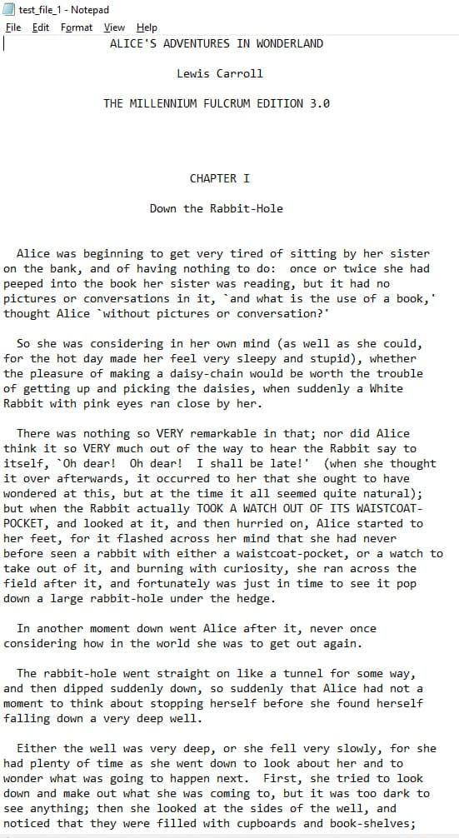
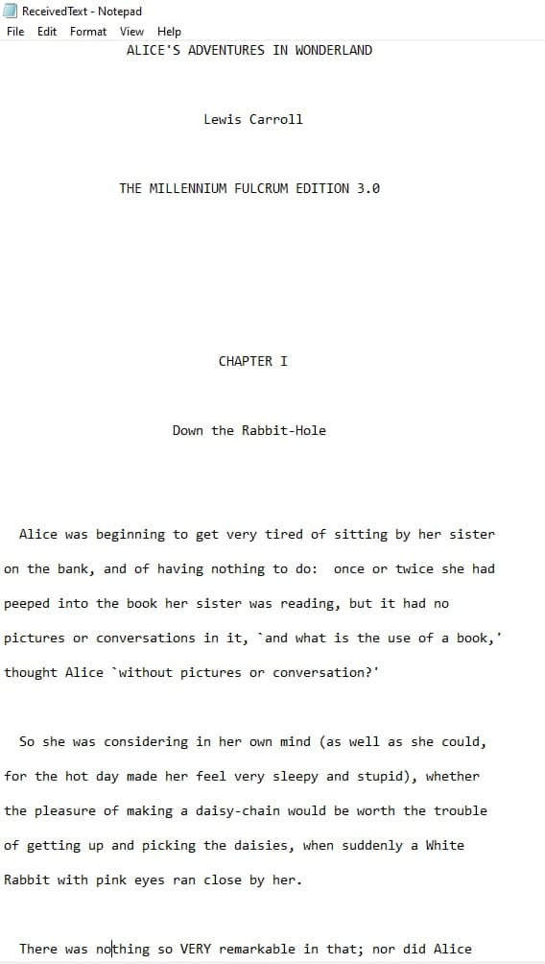
Files reception verification

Slide 4
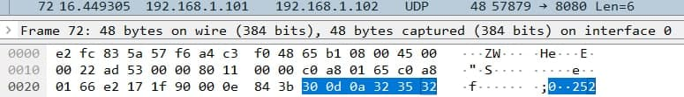
Wireshark

Slide 5
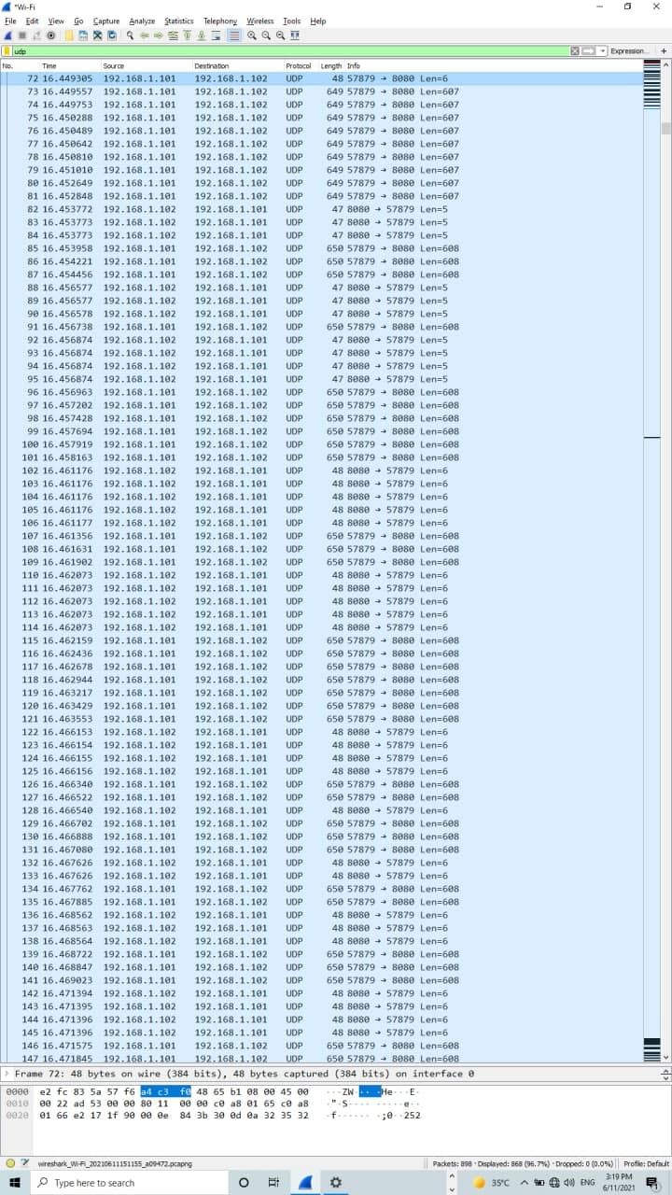
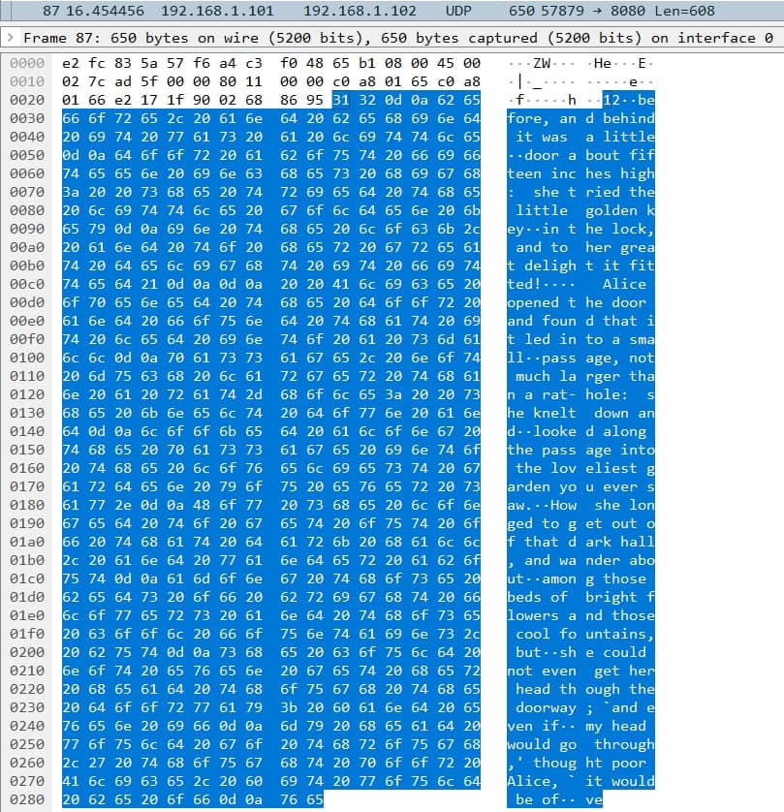

Slide 6
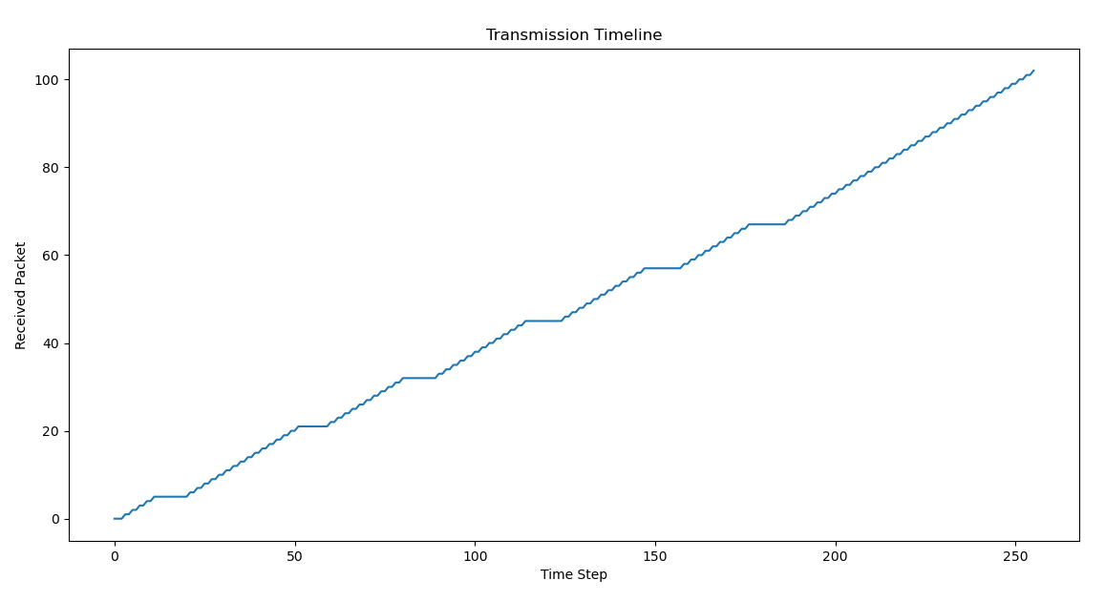
Received Packet Plot
file 1:

Slide 7
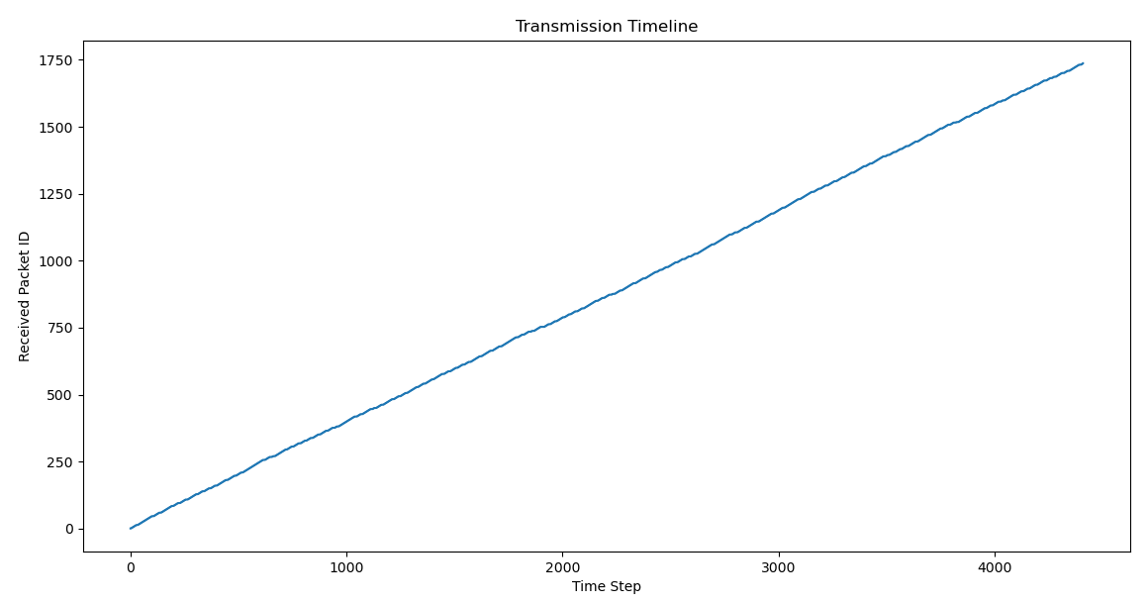
Received Packet Plot
file 2:

Slide 8
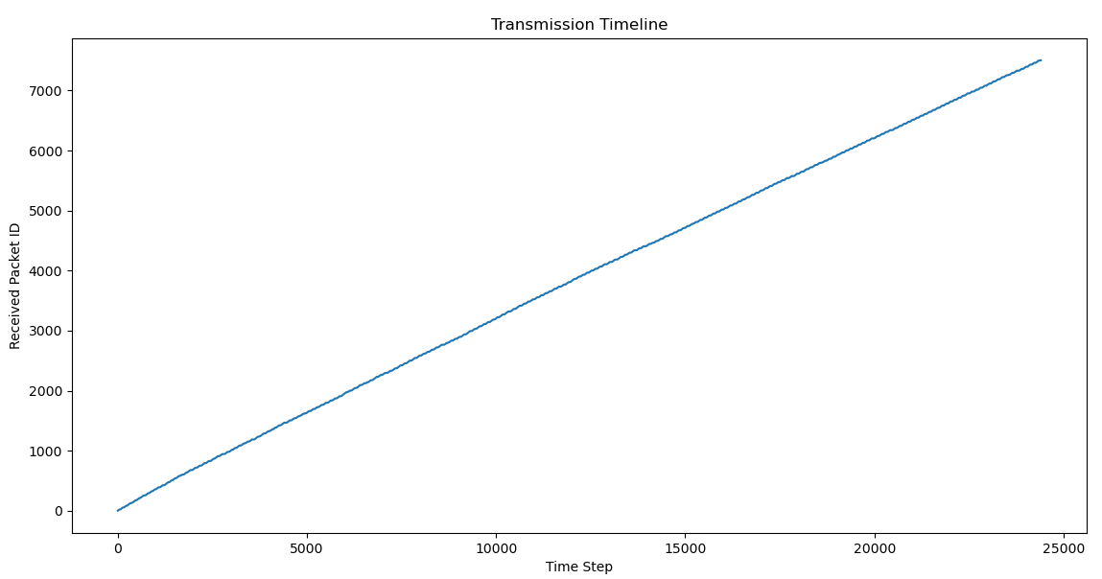
Received Packet Plot
file 3:

Slide 9
Optimized parameters
Test_file_1.txt:
MSS = 1460
N = 10
timeout = 0.01
Transmission rate = 705.3573 KB/s
Test_file_2.txt:
MSS = 1460,
N = 20,
timeout = 0.001
Transmission rate = 944.7034 KB/sec
Test_file_3.txt:
MSS = 1460,
N = 30,
timeout = 0.0001
Transmission rate = 646.48088 KB/s

Slide 10
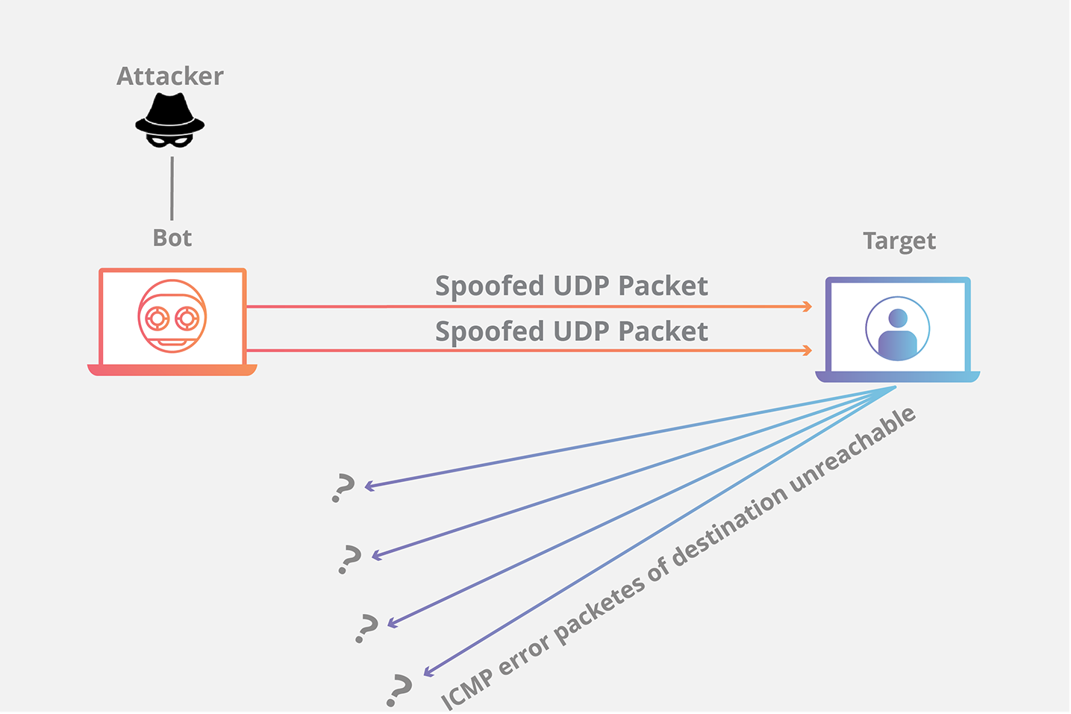
UDP Flood attack
https://www.cloudflare.com/img/learning/ddos/udp-flood-ddos-attack/udp-flood-attack-ddos-attack-diagram.png

Slide 11
Improvements
Retransmit the only lost packet
Buffer received out-of-order packets
End the timer in case of duplicate acks and retransmit the packet.

Slide 12


